Slide 1
Working with the University
“How to make the most of my collaboration?” workshop
Tannaz Pak T.Pak@tees.ac.uk
Clair Cooper Clair.Cooper@tees.ac.uk
Desire Dalton D.Dalton@tees.ac.uk
Diana Feliciano D.Feliciano@tees.ac.uk
Ambroise Baker A.Baker@tees.ac.uk

Slide 2
Workshop’s outline
Why this workshop
Types of collaborations
Examples or collaboration and academic expertise
Open discussion and Q & A
One-to-one discussions

Slide 3
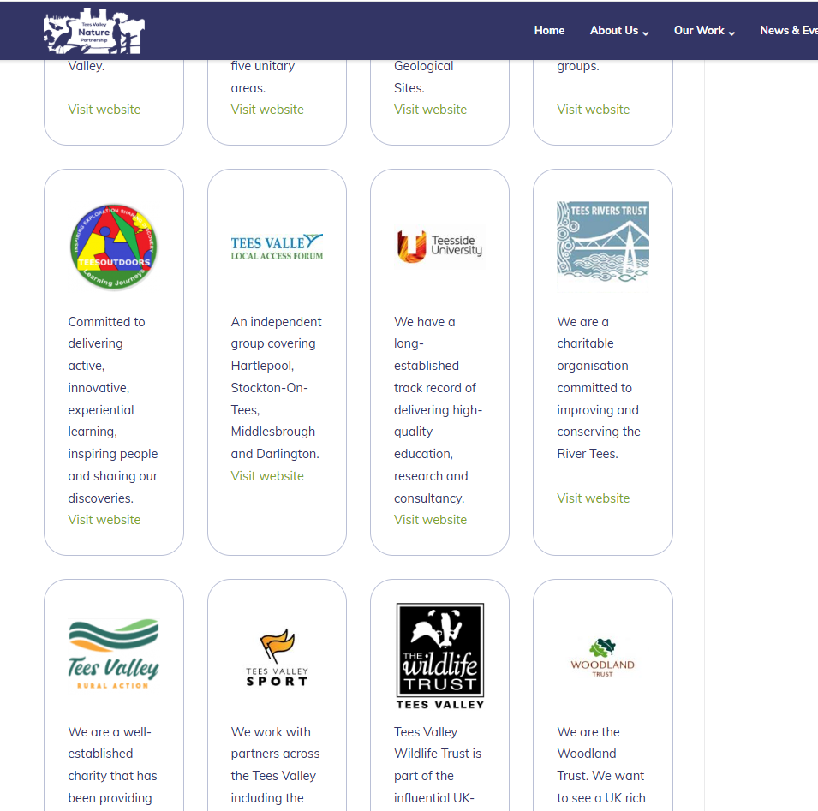
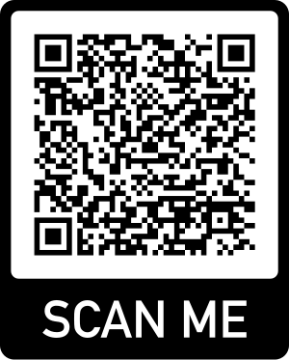
Why this workshop?
Teesside University “We have a long-established track record of delivering high-quality education, research and consultancy.”
What does this mean for you and your organisation?

Slide 4
Type of collaborations
Mostly based on collaboration with a specific academic working at the university:
Access expertise - advice, steering committees, network.
Partner for funding, add value to your project (research)
Gain critical insights for your project requiring specialised skills (consultancy)
Train your staff (CPD Continuous Professional Development), e.g. GIS, Plant Identification, etc.
Involving university students… can take various shapes

Slide 5

Access to expertise / specialist
Background in environmental consultancy
Second career as practitioner and academic in the health sector
J.Mankelow@tees.ac.uk
Special interest in patients with persistent pain and connecting with outdoors.
Dr Jaj Mankelow
- Rehabilitation sciences
- Physiotherapist
Notes:
The dinosaur links to how long ago I did my environmental studies but my interest has never waned and could not. Of interest it is the Oxfordshire dinosaur, I did my studies at Oxford Brookes, so it’s not a completely random link!

Slide 6
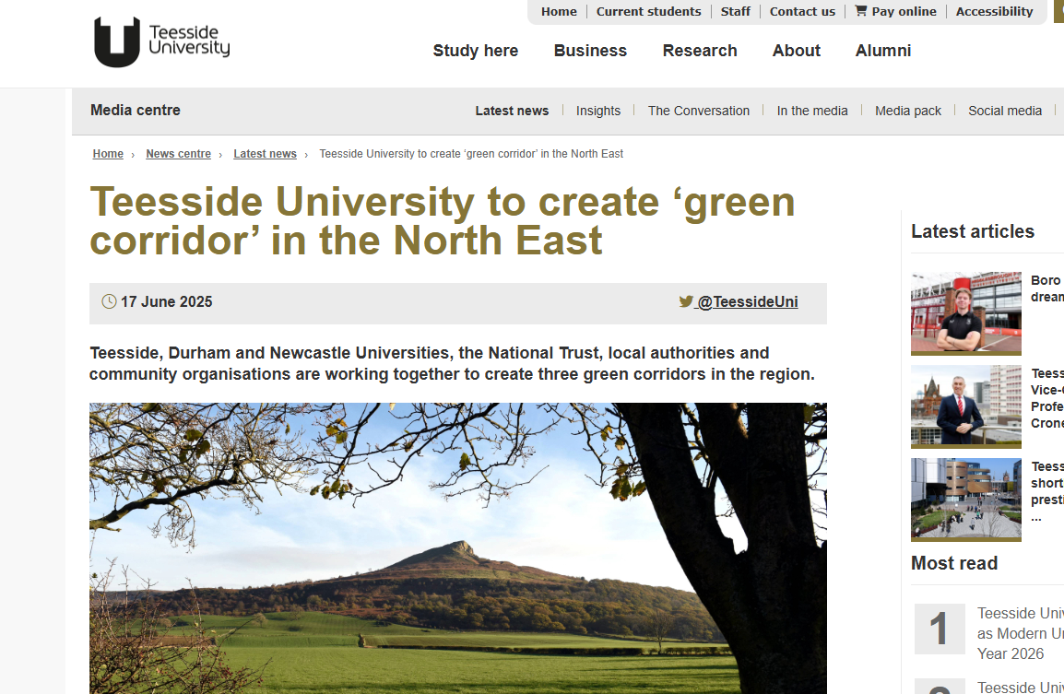
Partnering for funding
Green Corridor North East
Prof Sarah Perks
Prof Diana Feliciano
Dr Paul Stewart
Dr Laura Sillars

Slide 7
Hydrogen and Decarbonisation Research Group
Project Title | Funding Body | Duration
African Agriculture KTP: Valorisation of cassava waste through biochar for water treatment and soil enhancement. | Innovate UK | 2024-2026
Project TENET: Innovative direct air capture technology for cheaper and energy-efficient approach to removing and storing CO2 | Innovate UK | 2023-2024
Carbon Capture Ready? – Developing a Toolkit for Industry to Enable Carbon Capture within Energy from Waste plants in the Tees Valley | Innovate UK | 2023-2024
CalyChar: Calcium oxide and lysine functionalised hydrochar | NERC (CO2RE Pathfinders) | 2024-2025
Research England Hydrogen Innovation Project | UKRI | 2023-2026
Developing bio-promoters for CO2 mineralisation to useful carbonate products for industry and construction sector | The Royal Society | 2022-2024
Machine Learning for Single Phase and Multiphase Flow Leak Detection | Qatar Foundation | 2023-2026
MEVOCRETE: The scale up of material evolution technology for net zero emission concrete | Innovate UK | 2022-2024
AMIGO-Biochar: Advanced Manufacturing of Biochar in UK/ China/ Malaysia and Nigeria | British Council | 2020-2023
Tees Valley Hydrogen Innovation Project | ERDF | 2018-2023

Slide 8
Centre for Biodiscovery – specialised skills in:
1. Wildlife Genetics for Conservation and management
2. Disease Surveillance and Zoonotic Risk Monitoring
3. Forensic Applications – wildlife crime
4. Collaborative Research and Capacity Building
Co-supervised student projects aligned with conservation priorities.
Access to laboratory facilities and analytical expertise.
Joint funding applications and publication opportunities.

Slide 9


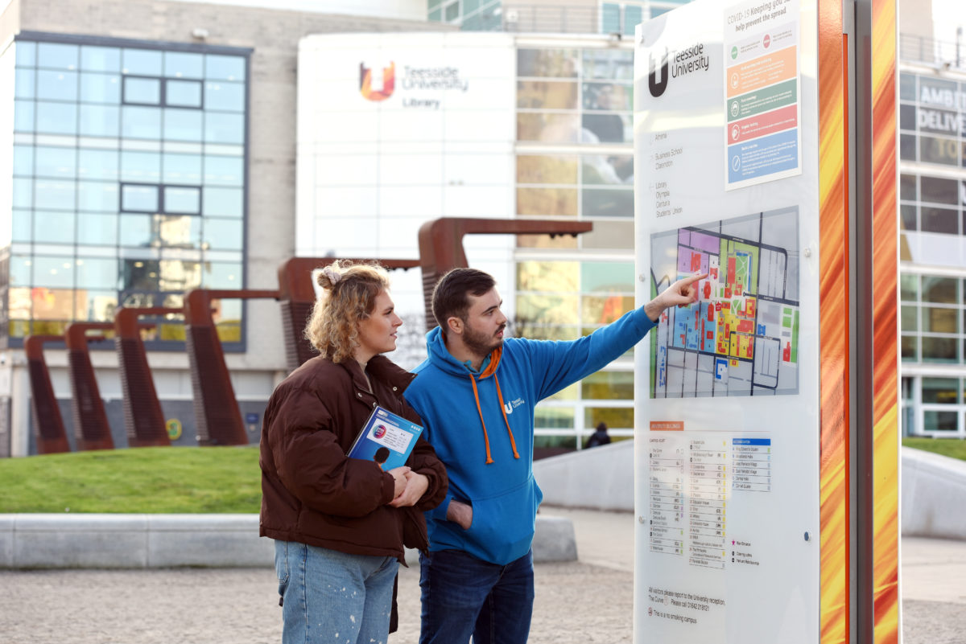
PhD research students – 4 years
Students
R & D for your work
Train your staff (PT)
Student projects – 4 months
Teach our students
Talent acquisition
Internships / work experience
Part of your mission
Seek volunteers
Enriching student life

Slide 10
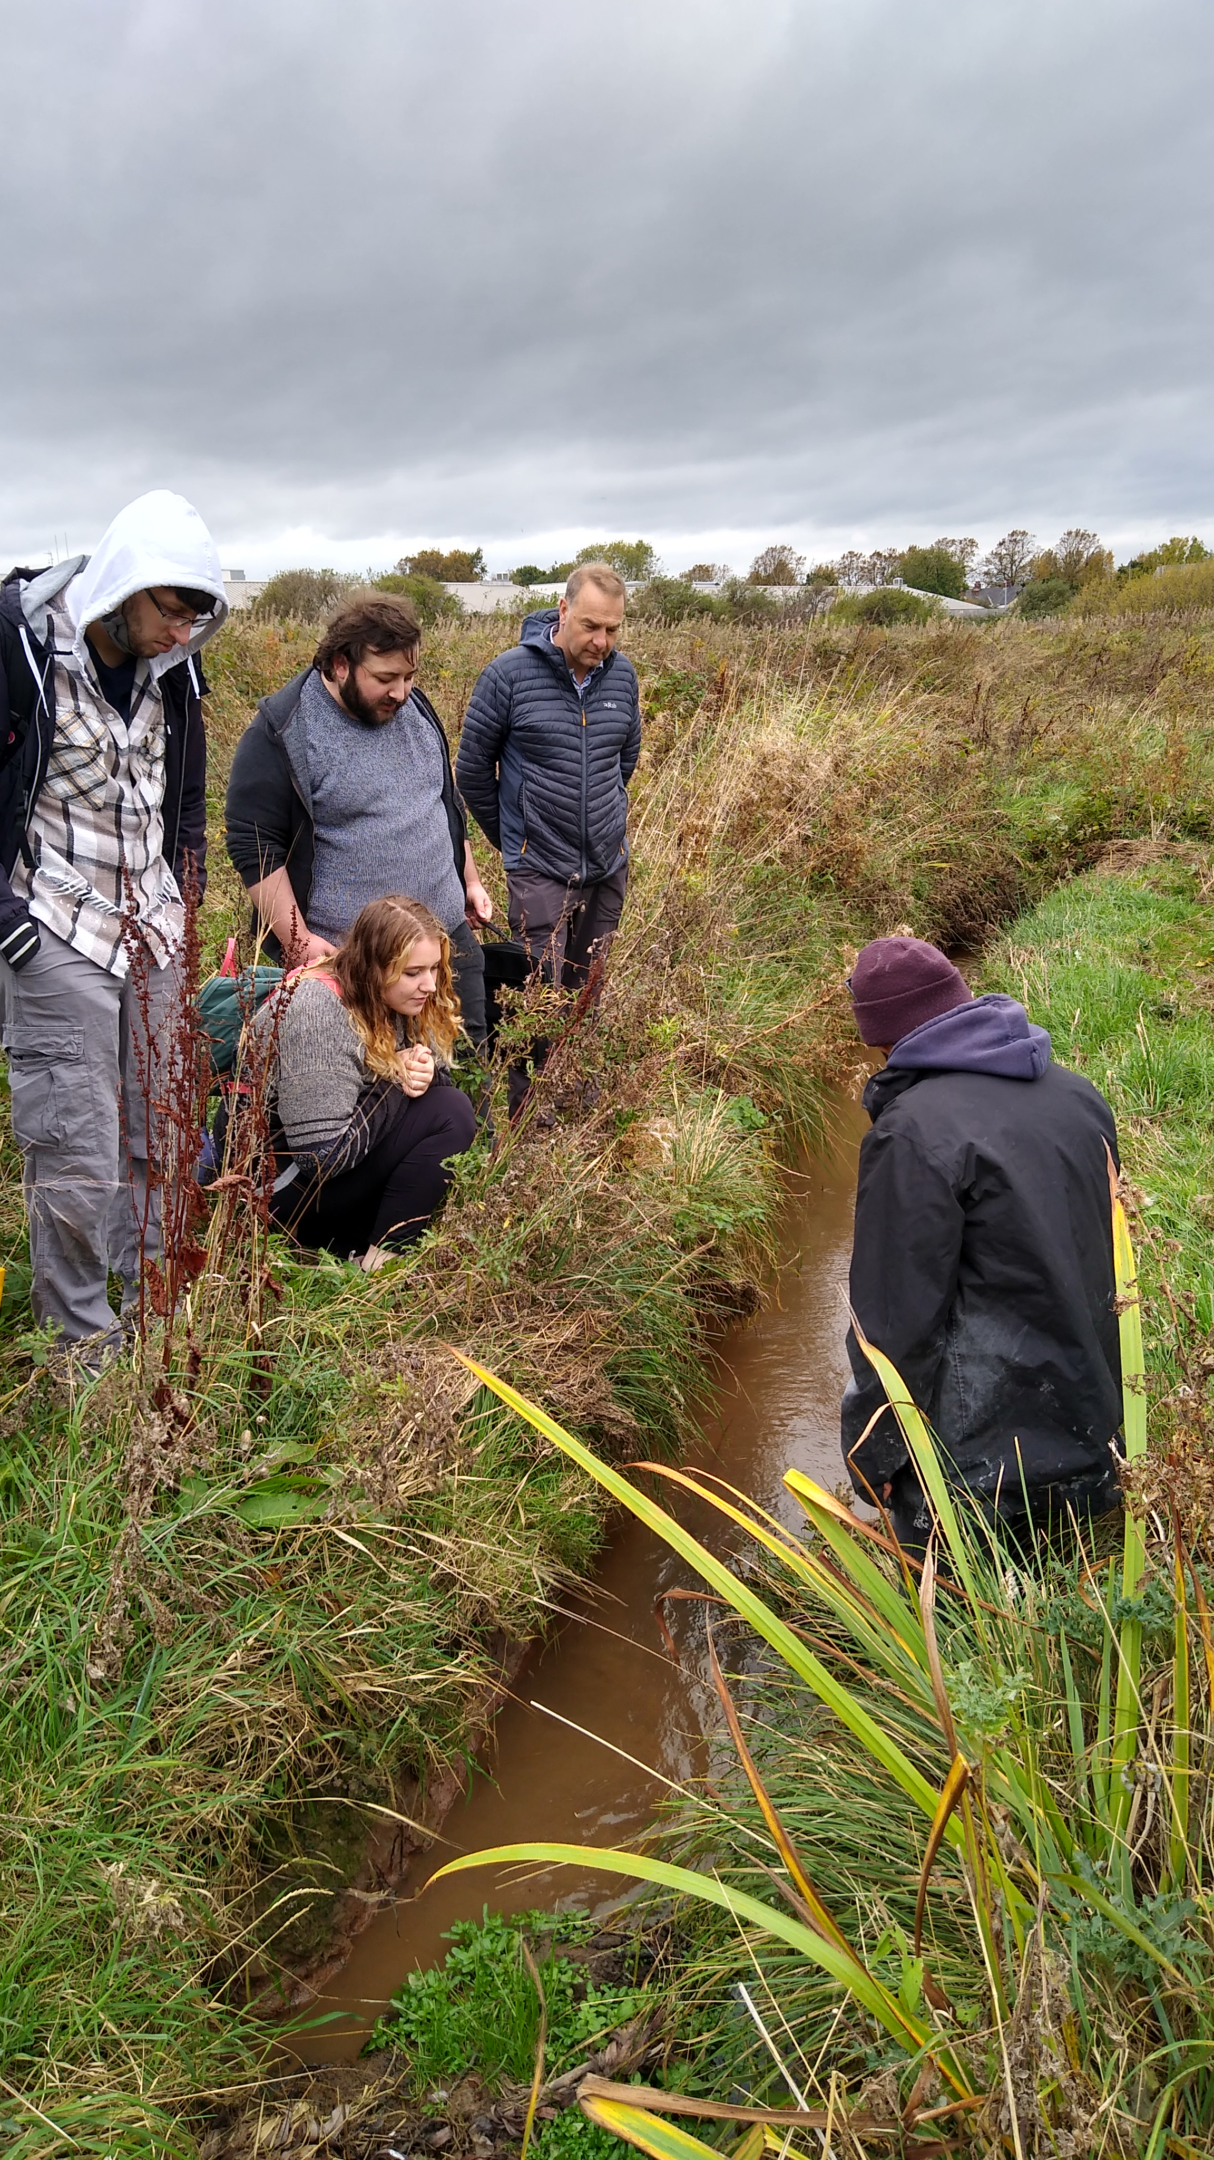
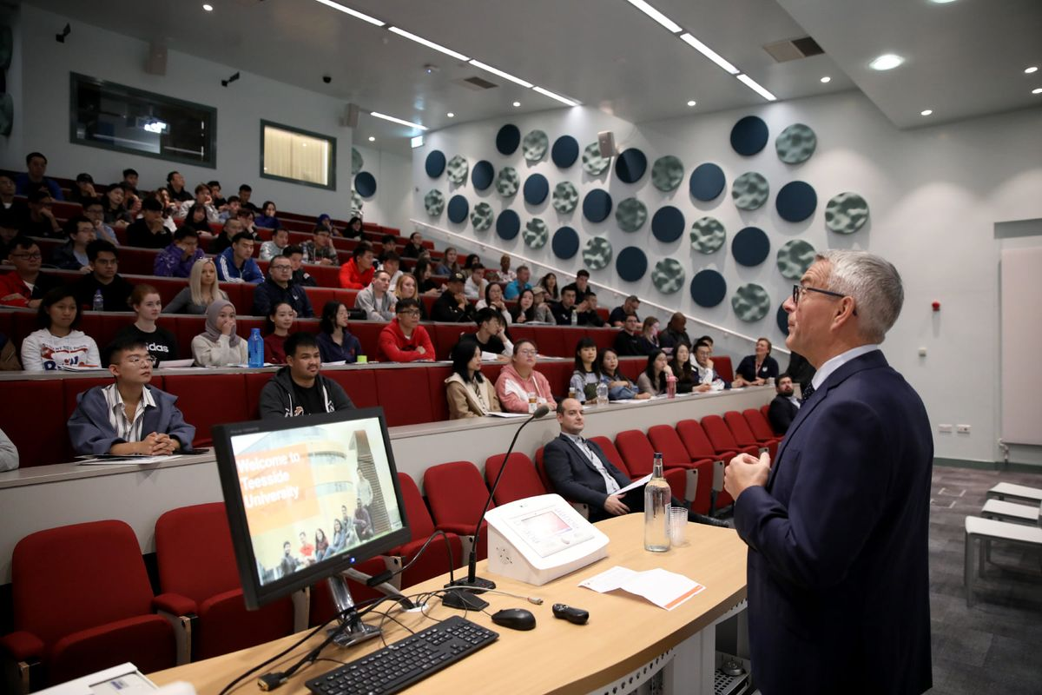
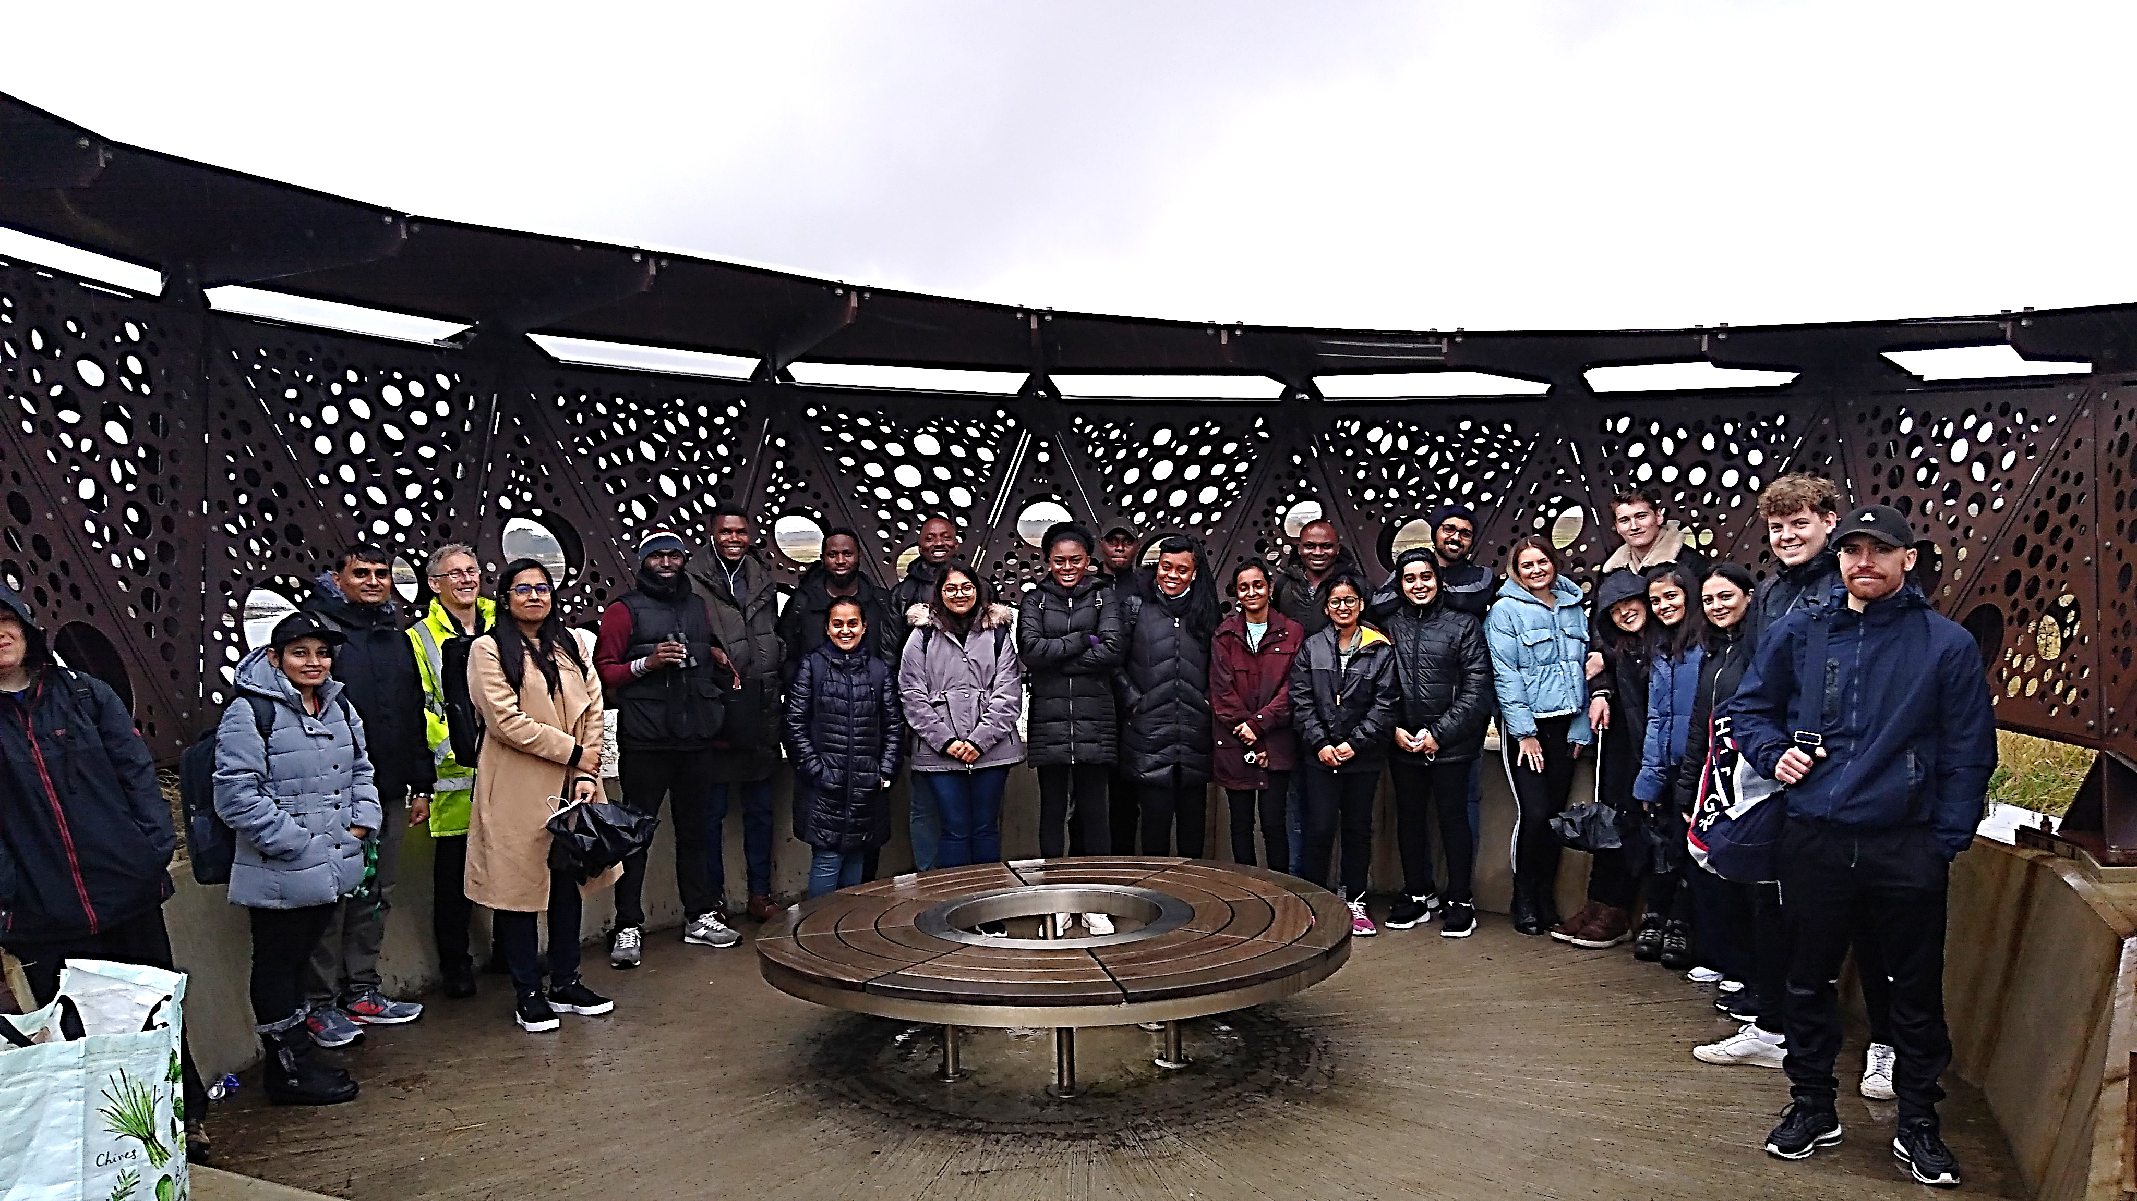
Teaching our students (e.g. TVNP, RSPB, INCA)
Guest lectures
Field trips
Career fairs

Slide 11
Colleagues with an interest in TVNP activities
Representative examples across Uni:
Mehnaz Rashid – Nature-based solutions, water quality and GIS
Tannaz Pak – Engineering and digital technology
Clair Cooper – Perception of net zero and nature
Richard Lord - Geosciences and geo-environment
Desire Dalton – Animal genetics, disease and ecology
Jagjit Mankelow – Links to human health
Diana Feliciano – Climate change policy
Sarah Perks – Arts, Culture and Creative Methodologies

Slide 12
Open discussion and Q&A
"Is there anything you wish the University did more of to support your work?”

